Slide 1
Lean for Life
CLASS 1
Food Journaling
Personal Eating Behaviors
Healthy Eating Basics

Slide 2

Today’s Class
Weight
Body Fat %
Food Journaling Practice
Health or Halo?
Personal Eating Behaviors
Healthy Eating Basics
Week 1 Nutrition & Fitness Challenge

Slide 3
Food Journaling:
Analyze this Breakfast
½ cup rolled oats
1 small gala apple, chopped
½ teaspoon cinnamon
½ cup unsweetened soymilk
½ teaspoon Truvia
1 Tablespoon chia seeds
12 ounces coffee
3 Tablespoons non-dairy vanilla creamer

Slide 4
Food Journaling:
Analyze this Breakfast
399 calories
61 g carbohydrates
25 g sugar
13 g fiber
13 g fat
13 g fiber
0 mg cholesterol
1 Tablespoon chia seeds

Slide 5

Health or Halo?

Slide 6

Health or Halo?

Slide 7
Why?
Ingredients: Nonfat yogurt (cultured grade A non fat milk, modified food starch, fructose, kosher gelatin, vitamin A palmitate, vitamin D3), water, blueberry puree, fructose, contains less than 1% of modified corn starch, natural flavor, blue 1, red 40, aspartame, potassium sorbate (to maintain freshness), acesfulfame potassium, sucralose, malic acid, sodium citrate.
High in sugar
Low in protein
Artificial:
  Sweeteners
  Flavorings
  Colors
Notes:
Is this food?

Slide 8
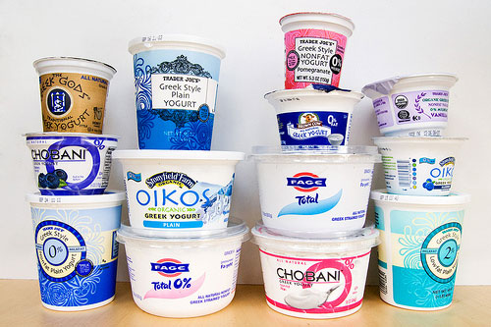
Go Greek!
Notes:
Greek yogurt or plain, low fat organic yogurt. The only ingredients in your yogurt should be milk and live cultures. One container of greek yogurt as 13 grams of protein – that’s as much as 2 eggs!

Slide 9
Why?
High in protein
Low in fat and cholesterol
High in probiotics
No artificial ingredients
Filling!

Slide 10
Personal Eating Behaviors
Do you have specific “weak” times of day?
Do you stress eat?
Do you eat when you’re bored or doing a monotonous task?
Are you a night-time or TV snacker?
Do you crave sugar 1-2 hours after lunch?
When do you always make healthy choices?
When is it the easiest to make healthy choices?
When is it the hardest to make healthy choices?

Slide 11
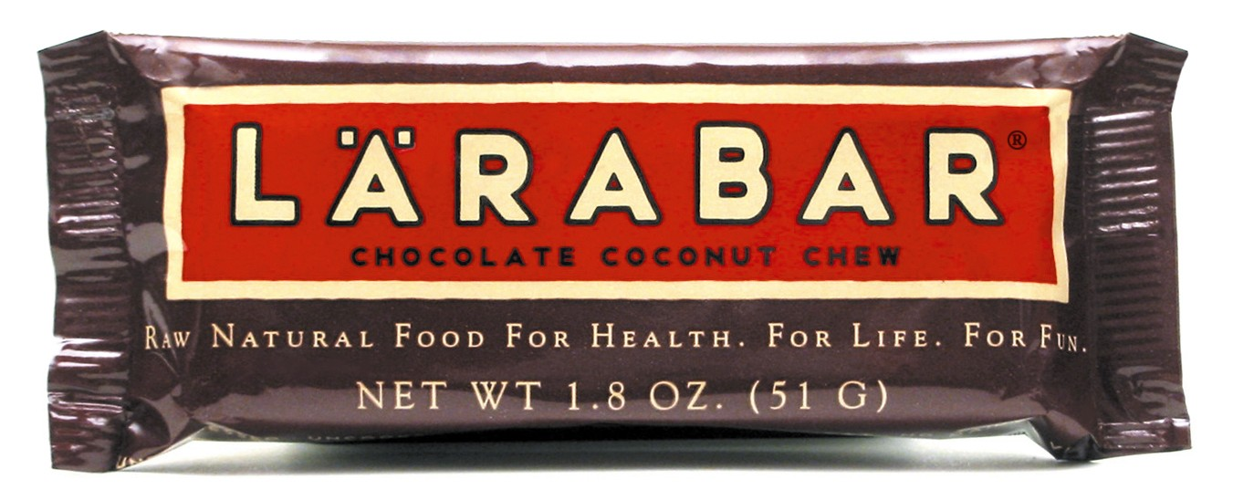
Personal Eating Behaviors
SOLUTIONS
The Cookie Tray: Always be prepared with a CLIP!
  (Chocolate Larabar In Pocket)
Sip on green, chamomile, or peppermint tea during times of stress
Have raw veggies on hand for boredom snacking

Slide 12

Personal Eating Behaviors
SOLUTIONS
Have a 2nd plate of veggies
Drink water before, during, and after meals
Eat a small snack before going out or to a party
Save a portion of your dinner for a night-time snack
Snack on a small serving of Barbara’s Cinnamon Puffins Cereal with a hot cup of chamomile tea at night

Slide 13
Healthy Eating Basics
High Fiber: 40 grams daily
  10 grams per meal
  5-10 grams per snack
  4 veggies per day: 16 g fiber
  3 fruits per day: 9 g fiber
  ½ cup beans/ lentils: 7 g fiber
Water: ½ your body weight in ounces daily
  200-lb person needs 100 ounces daily
½ Plate Veggies at Lunch & Dinner
LOTS of Whole Foods & Few Processed Foods
  Fewer unhealthy food cravings
  Better mealtime satisfaction

Slide 14
Healthy Eating Basics
BREAKFAST: 300-500 calories, 10-15 g fiber
Largest Meal of the Day!
  1-2 servings of whole grains
  1 serving of protein
  1-2 servings of fruit
  Extra credit: 1 serving of veggies
LUNCH: 300-500 calories, 10-15 g fiber
  1-2 servings of whole grains
  1 serving of protein
  2 servings of veggies
  1 serving of fruit

Slide 15
Healthy Eating Basics
DINNER: 300-500 calories, 10-15 g fiber
Smallest Meal of the Day!
  1 serving of whole grains
  1-2 servings of protein
  2 servings of veggies
SNACKS: 2 PER DAY: 100-300 calories, 5-10 g fiber
  1 serving of protein
  1 serving of veggies
  1 serving of fruit

Slide 16
Healthy Eating Basics
1 serving Whole Grains
  ½ cup cooked grain (such as oatmeal or pasta)
  1 oz. dry cereal (usually ¾ cup to 1 cup)
  1 slice of whole grain bread
  ½ pita bread or tortilla
  1 bagel = 4 servings
1 serving Protein
  *at least 1 serving/day of beans/lentils
  ½ cup of cooked beans
  ¼ cup bean spread (hummus)
  3 oz. of tofu, tempeh, seitan, or meat alternative
  2-3 ounces of lean meat
  1 egg
  2 Tbsp nut butter
  1 oz. nuts (~ ¼ cup)

Slide 17
Healthy Eating Basics
1 serving Veggies
  *choose a variety of colors each day
  ½ cup cooked veggies
  1 cup raw vegetables
1 serving Fruit
  *emphasize berries (high-fiber, low-sugar)
  ½ cup chopped fruit or berries
  1 medium-sized piece of fruit (tennis ball)

Slide 18
Healthy Eating Basics
1 serving Veggies
  *choose a variety of colors each day
  ½ cup cooked veggies
  1 cup raw vegetables
1 serving Fruit
  *emphasize berries (high-fiber, low-sugar)
  ½ cup chopped fruit or berries
  1 medium-sized piece of fruit (tennis ball)

Slide 19
All Notes and Powerpoints on my blog!
BitchinDietitian.com/Lean-for-Life-Class

